Slide 2
Closing the testing gap:
High uptake of HIV self-testing among men in rural and peri-urban KwaZulu-Natal, South Africa
Adrienne E Shapiro, Alistair van Heerden, Meighan Krows, Kombi Sausi, Nsika Sithole, Torin T Schaafsma, Olivier Koole, Heidi van Rooyen, Deenan Pillay, Connie L Celum, Ruanne V Barnabas
@DrAShapiro

Slide 3
I have no conflicts of interest to declare

Slide 4

Men are missing from the HIV continuum of care, starting with testing
Proportion of HIV tests performed globally
Men test less in LMICs
South Africa introduced self-testing guidelines (2018) following WHO guidelines (2016) for HIV self-testing (HIVST)
Need to know how best to provide access to testing for men using HIVST & link to care/prevention
WHO 2015

Slide 5
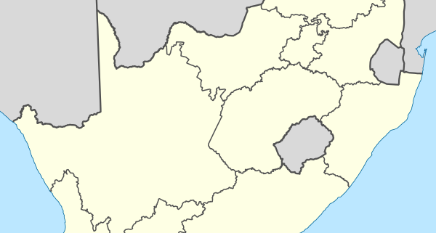
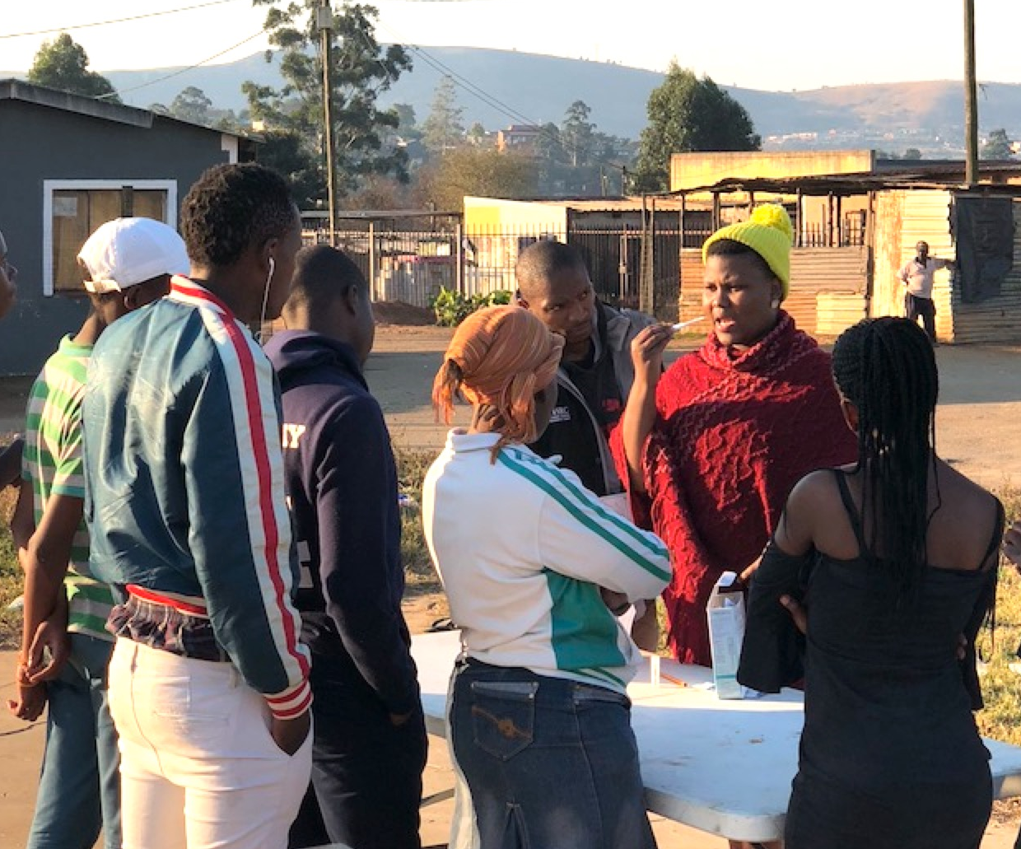
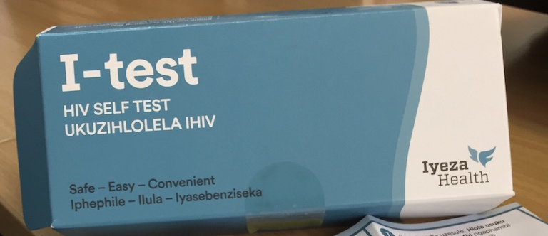
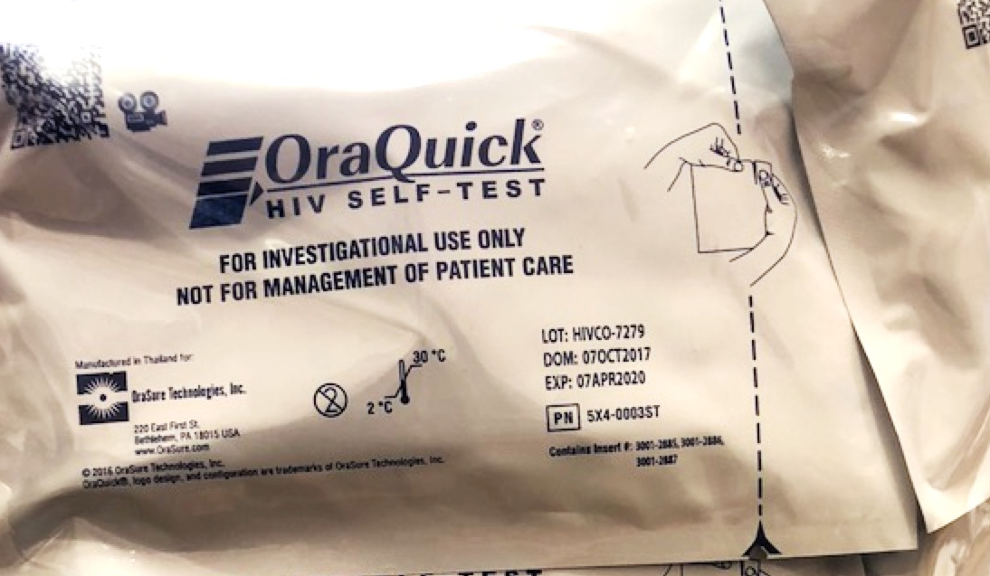
Engaging Men with HIVST
Implementation study of multi-venue community-based HIVST distribution targeting men
2 regions of KwaZulu-Natal, South Africa
  (Umgungundlovu, Umkhanyakude)
Choice of 2 HIVST options: oral-fluid or blood-based testing
In-person and/or video demonstration of how to use each test
Pictorial instructions provided in each kit

Slide 6
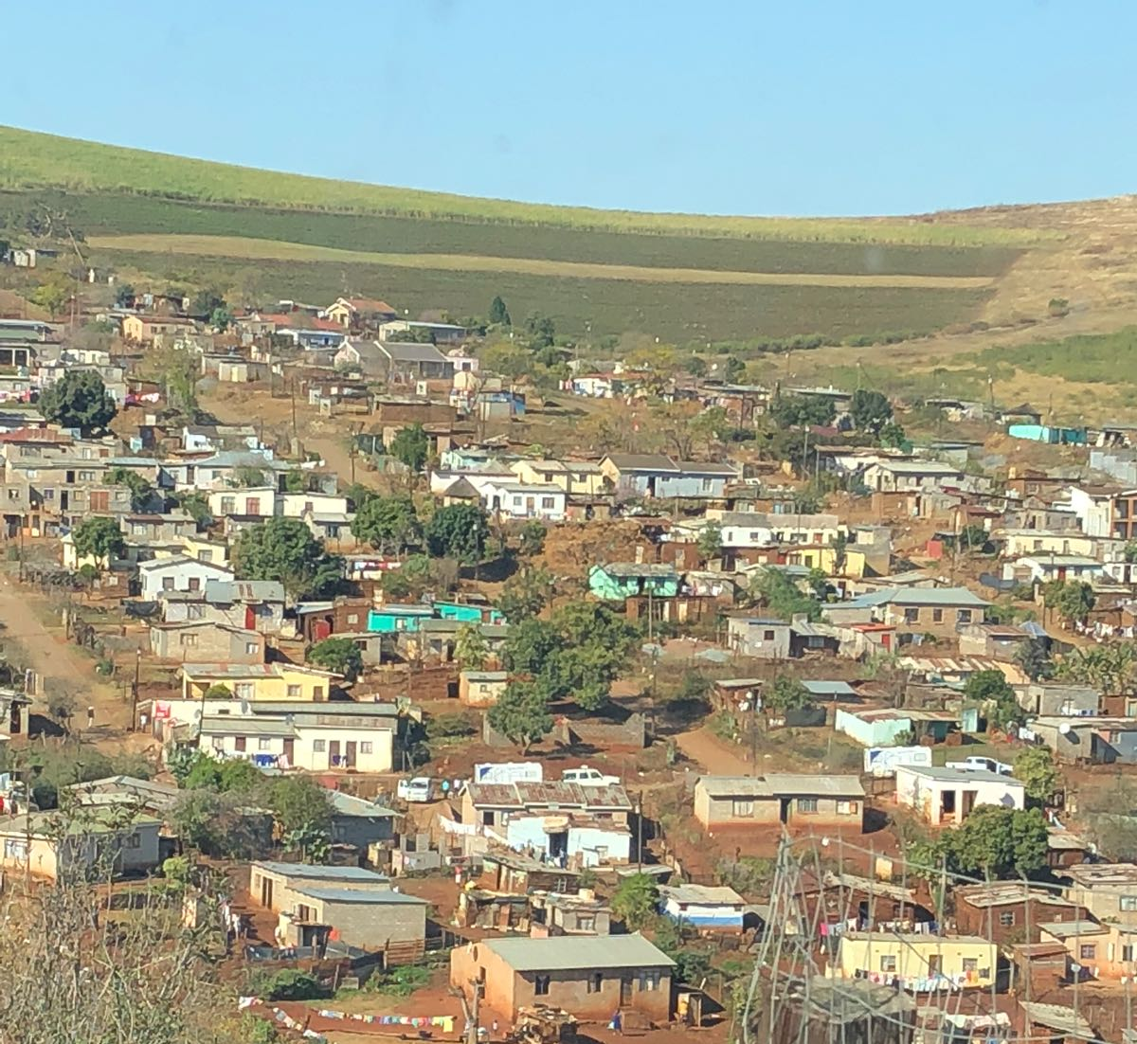
HIVST demonstration & distribution in diverse settings
Distribution venues:
  Community points (mobile van)
  Workplaces (construction sites, factories, industrial farms, taxi ranks)
  Social venues (taverns, bottle shops, sporting events)
  Index (HIV+) partner distribution

Slide 7

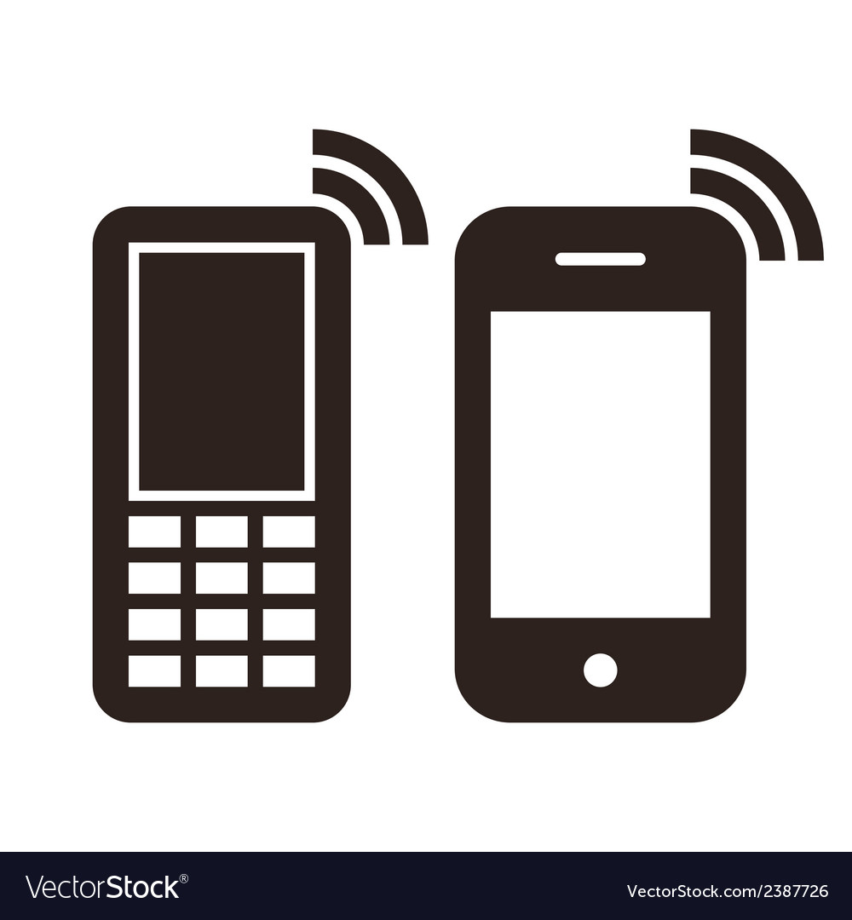
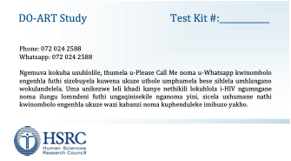
Project Implementation: On-site, Off-site, Partners
T
C
T
C
T
C
T
C
T
C
T
C
T
C
ZAR30
No result reported → SMS reminder to test (2 weeks) → staff outreach reminder call (2 months).
Staff outreach phone call after 4 weeks to confirm post-test linkage.

Slide 8
High-volume HIVST distribution in diverse venues
4,495 HIVST kits distributed
(July – Nov 2018)
218 kits given to HIV+ index participants for partner distribution
Project District | Atomo i-test (blood-based) | Oraquick (oral fluid)
Umgungundlovu (peri-urban) | 983 (53%) | 889 (47%)
Umkhanyakude (rural) | 1622 (62%) | 1010 (38%)

Slide 9
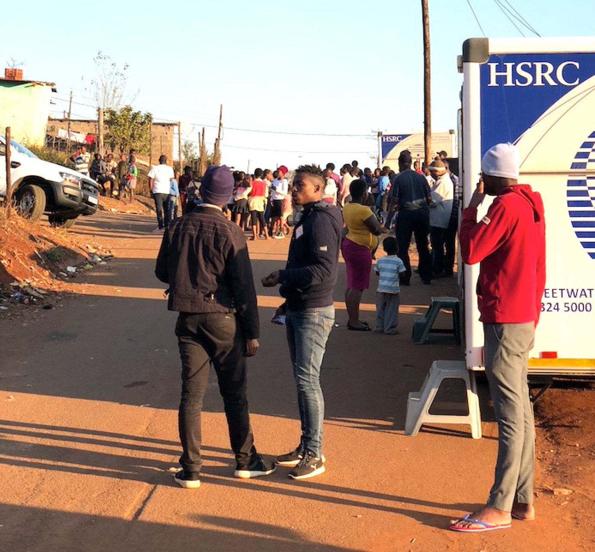
Population characteristics of persons receiving kits at distribution sites (N=4487 kits)
92% men
36% unemployed
54% circumcised (men only)
Current sexual partners: 3% none
              58% 1 partner
            36% 2+ partners
Alcohol use (drinks/week): 42% reported 0
                43% reported 1-6
                15% reported 7+

Slide 10
Men’s HIVST Preferences & Use Experiences
85% said reason for testing using HIVST was wanting to know HIV status.
  8% said more convenient than VCT
  3% for airtime incentive
93% said using test kit was “easy” or “very easy”
80% needed no additional help using kit
  19% had staff help
62% said in-person demonstration taught how to use kit
  60% read instructions
  15% said video demonstration
>90% of men would use the same test type again, few would switch.
Test used | Would prefer blood | Would prefer oral swab
Ora-quick | 140 (8.2%) | 1538 (90.3%)
Atomo i-test | 1935 (92.1%) | 141 (6.7%)

Slide 11
Testing & Linkage Cascade of 4307 HIVST kits to men
Tested on-site:
100% results known
11% HIVST+
81% Linkage known
60% Started ART
Kit taken off-site:
73% results known
4% HIVST+
81% Linkage known
72% Started ART

Slide 12
Predictors of a Positive HIVST Result in Men
N=3551/4286 (83%) with results reported
Older age (30+), uncircumcised status, primary education only, and unmarried status all associated with higher risks of HIVST+
No association with testing venue type, employment
Predictor |  | Adjusted Risk Ratio | 95% CI
Self-test location | On-site Off-site | -ref- 0.61 | (0.48 - 0.78)
Ever HIV tested before | Yes No | -ref- 1.96 | (1.47 – 2.63)
Alcohol use (drinks/wk) | 0-6 7+ | -ref- 1.85 | (1.41 - 2.40)
Need differentiated testing services
HIVST reaches men who have not tested before
HIVST reaches men at high risk due to alcohol use
Notes:
Expected demographic factors associated with a positive result: age, circumcision, lower educational status, non-married status.
Interesting predictors emerging from the testing scenario:, taking the test on-site, never having tested before, and moderate - heavy alcohol use were associated with positive HIVST result among men who tested using HIVST.
Alcohol use interesting – anecdotal reports that persons using alcohol (drunk) will be turned away from clinic sites; some men have reported using alcohol for courage prior to testing and being turned away – can’t consent – HIVST gets around this issue by giving men capacity to consent to test by electing to test, regardless of when they use alcohol.
Take out typical demographic factors – place as bullets nearby, highlight

Slide 13
High rate of linkage to care among HIV+ men testing with HIVST
81% (222/274) of men with positive HIVST result were successfully contacted to check linkage status
72% (159/222) of contacted HIVST+ received confirmatory test
95% (146/153) who had a +confirmatory test initiated ART
  (68% overall linkage)
No clear predictors of linkage to care found among men with HIVST+
Reasons given for not linking to care:
There will be long queues at clinic.
I am working during the time when clinic is open
Haven’t had time to go to clinic

Slide 14
Lessons learned & Limitations
Self-reported results, linkage
  Subset validated with clinic records
HIVST overcomes barriers to testing but not barriers to linkage
  Convenience, Time
  Transport
  Work
  Stigma
Notes:
Availability of testing alone is not sufficient to facilitate linkage to care/ART initiation for some people – some will need additional support to initiate ART. Community-based ART initiation?

Slide 15
Discussion
Rapid deployment of kits with support is a feasible approach to reach men (~1000 kits per month)
“Differentiated testing” important
  Test kit type option
  Demonstration & directly-assisted testing options
  Multiple venues
Minimal incentives facilitated some results reporting & engagement
High rate of linkage/ART initiation among men who could be contacted (68%)
Next steps: improve linkage to both HIV care and prevention

Slide 16
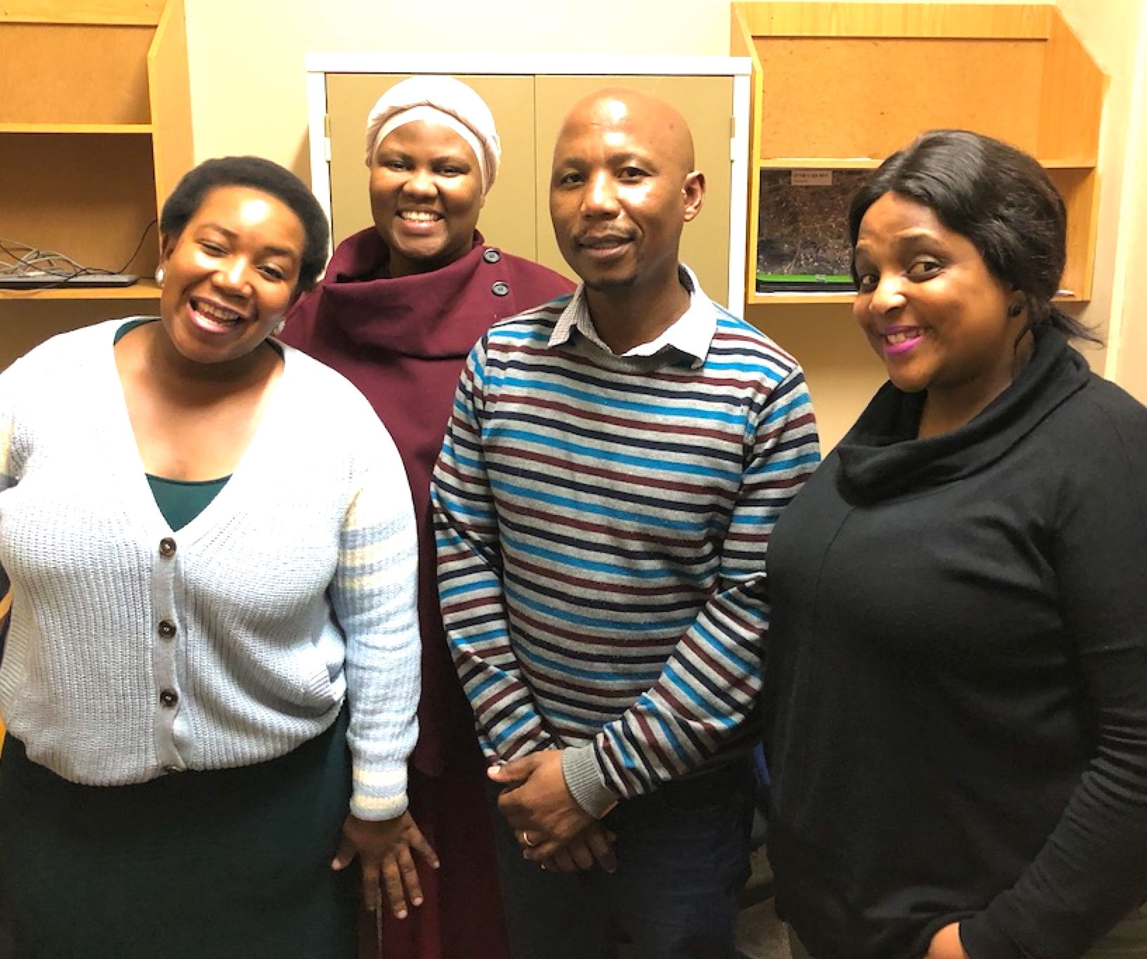
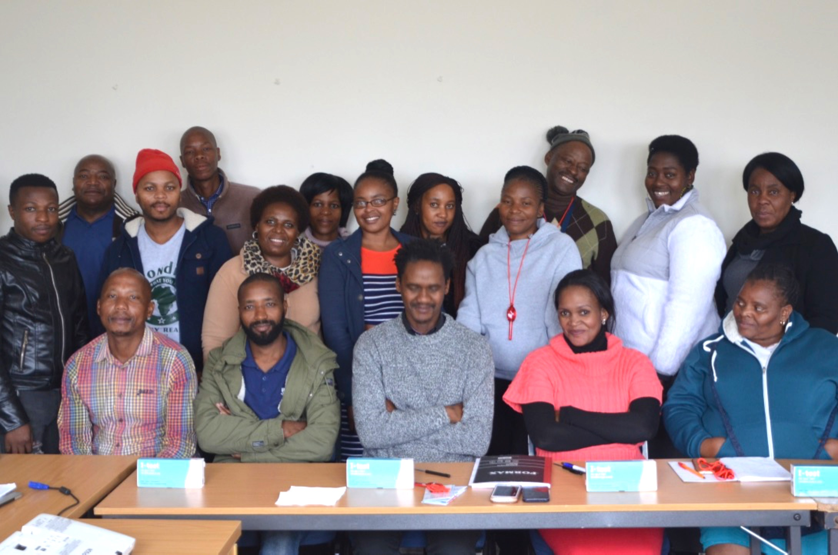

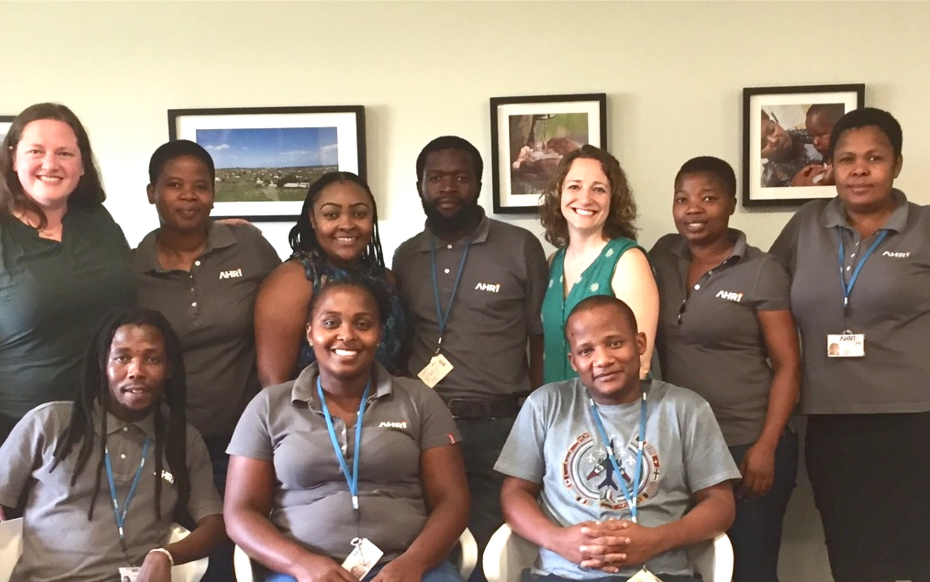




Study Team & Support
Principal Investigator: Ruanne Barnabas
Protocol co-chair: Connie Celum
Site PIs: Heidi van Rooyen, Alastair van Heerden
The DO ART Study
Site PIs: Deenan Pillay, Olivier Koole
We are grateful to all participants in the study

Slide 17
Rapid HIVST distribution with non-intensive staff support is a feasible, acceptable approach to identify HIV+ men and link them to care & ART in South Africa.

